Slide 1
Managing Up:
Turning Your CEO into a Fundraising Rock Star
Roselle M. Ungar, CFRE

Slide 2
Let’s Get Into Your CEO’s Head
What would your CEO want you to get out of this session?
Notes:
Ask for people to shout out answers.
Take 2 minutes to think about how to make my CEO’s fundraising life easier.
1 minute report back

Slide 3
Take Aways from this Session
Empower your apprehensive CEO to become comfortable fundraising
Establish a positive partnership with your CEO
Create a workable plan for your CEO at a pace that will result in success

Slide 4
What is Managing Up?
A Definition:
Influencing someone with power over you.
Managing up requires general influence skills, relationship management, negotiation techniques and working well with others.
Hight Performance Group, Inc.:
The Courage to Manage Up

Slide 5
Managing Up is …
“The process of consciously working with your boss to obtain the best possible results for you, your boss and your organization.
This is not political maneuvering or kissing up. Rather, it is a deliberate effort to bring understanding and cooperation between individuals who often have different perspectives.”
“Managing Up”, Thomas Zuber and Erika James

Slide 6
How Much of the Day Does your CEO Spend on Fundraising?
0 – 25% of time
26 – 50% of time
51 – 75% of time
76 – 100% of time

Slide 7
The Average CEO spends under 5% of time on individual fundraising …
A prescription for disaster!

Slide 8
The engine that runs most non-profits is …
FUNDRAISING
Then shouldn’t your CEO be spending the better part of their workday on this function?

Slide 9
Most CEOs would rather have a root canal than make a solicitation call on a wealthy prospect!
Notes:
Tell Deana’s Story

Slide 10
Are You Living Up to Your Fundraising Responsibilities?
Questions for the CEO:
If you are the CEO, you ought to be able to answer “yes” to all the following questions:
____ Is fundraising part of your job description?
____ Do you, your development department, and your board work as a fundraising team?
____ Do you go out on solicitation calls frequently?
____ Do you keep your development staff informed about what’s going on throughout your organization?

Slide 11
If you are the CEO, you ought to be able to answer “yes” to all the following questions:
____ Do you meet with your development staff regularly?
____ Do you work with your board and development staff in making presentations to foundations and corporations?
____ Do you consider fundraising to be a key part of your job?
____ Do you set a positive fundraising tone for your whole organization?
Are You Living Up to Your Fundraising Responsibilities?
Questions for the CEO:

Slide 12
Are You Living Up to Your Fundraising Responsibilities?
Questions for the Development Professional:
If you are the development director, you ought to be able to answer “yes” to all the following questions:
____ Do you make it clear exactly what fundraising tasks you want your CEO to perform?
____ Do you let the CEO know when you need help making a contact or motivating a board member?
____ Do you provide a written list of fundraising duties for the CEO and a timetable outlining when each should be done?
____ Do you meet with the CEO regularly to report on fundraising activities and CEOs?

Slide 13
Are You Living Up to Your Fundraising Responsibilities?
Questions for the Development Director:
If you are the development director, you ought to be able to answer “yes” to all the following questions:
____ Do you respect the CEO’s time constraints and understand that fundraising is only one of many CEO duties? At the same time, do you continually reinforce the importance of fundraising for the CEO?
____ Do you brief the CEO on potential donors and the best way to solicit them?
____ Do you treat the CEO as a crucial member of your fundraising team?
____ Do you give the CEO written reports at the end of each fundraising event and campaign?

Slide 14
Are You Living Up to Your Fundraising Responsibilities?
Questions for the Development Director:
If you are the development Director, you ought to be able to answer “yes” to all the following questions:
____ Do you take the time to help the CEO become more and more comfortable with the role of asking for money?
____ Do you act as a fundraising coach and educator for the CEO?
Notes:
In our brief time together – lets really focus on the last 2 questions:

Slide 15
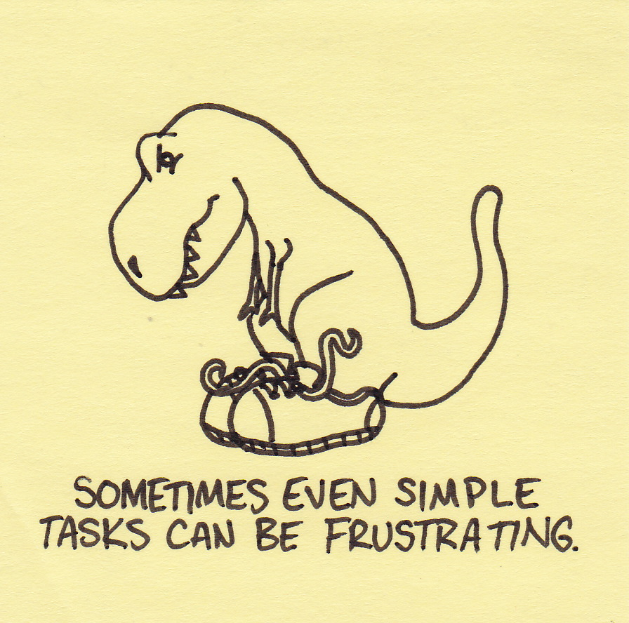
Do you take the time to help the CEO become more and more comfortable with the role of asking for money?
Notes:
Brainstorm – but also give ideas
BEGINNER TASK
Thank you calls
Thank you notes
One reason some executives feel uncomfortable simply saying “thank you” is that they feel like there should be a further agenda. If you feel this way, try thanking donors by reporting back on what their generosity has accomplished. As the chief executive, you should be able to ask your development team to prepare a report on what a person’s donation has helped your nonprofit accomplish.
These are more effective if you know what the donor values. You’ll soon grow to enjoy showing your donor how her giving connects directly with something she is passionate about!
Visiting with donors top down – just visit and find out why your organization is important to them – share a brief programing update.
Building public awareness
Meeting new potential donors
Advice Visits

Slide 16
Begin with simple tasks and work your way up
Solicitation
visits
Advice visits
with prospective donors
Stewarding visits
with current donors
Thank you notes - Thank you calls
Notes:
Brainstorm – but also give ideas
Thank you calls
Thank you notes
Visiting with donors top down – just visit and find out why your organization is important to them – share a brief programing update.
Building public awareness
Meeting new potential donors
Advice Visits – Gail Perry: If you want money, ask for advise – if you want advice, ask for money”

Slide 17
Schedule Weekly Check-In Meetings
Who attends?
Development Director
CEO
The person who manages the CEO’s schedule
Notes:
Just the three of you. Uninterrupted for an hour. Non-negotiable. Minimum of 45 minutes. Probably more like an hour.
Yes, it’s every week.
But it’s one hour. It might be the most important hour you spend each week for the health of your organizations.
The executive assistant is a ‘must’ in this meeting. You need to set up meetings with potential donors. Getting meetings is not easy – the folks you want to meet with are in high demand. EVERYONE wants to meet with them!!! You simply cannot underestimate the importance of the art and science of scheduling.
Do not forget to capture all agreed upon action items. Assign someone to capture them and circulate them that very same day.
Recirculate the action items 48 hours before the next meeting as a reminder / catalyst / cattle prod.

Slide 18
What A Development Director Should Bring to Every Meeting
Fundraising Dashboard
Special Events
Staff Update
Development Director Ask List
CEO Ask List
Notes:
Fundraising dashboard. The simplest of dashboards that tell a quick story about fundraising. The dashboard should be developed together by the E.D. and the Director of Development so that it suits the needs of all.
Special events. A one-page update on any special event activities. If this is a recurring event, some historical context that the E.D. can share with the board (how we are doing relative to same time last year)
Staff Update. Successes, challenges, professional development, “marketing” the successes of anyone the CEO is questioning.
D.D. Ask List. For the Dev. Director. Your own ASK list for the week. Who are you meeting with? Who is on you target list to schedule time with.
E.D. Ask List. An ASK list for the E.D. For this last part of the meeting, make sure the executive assistant can talk about open blocks and how the meeting should be set up

Slide 19
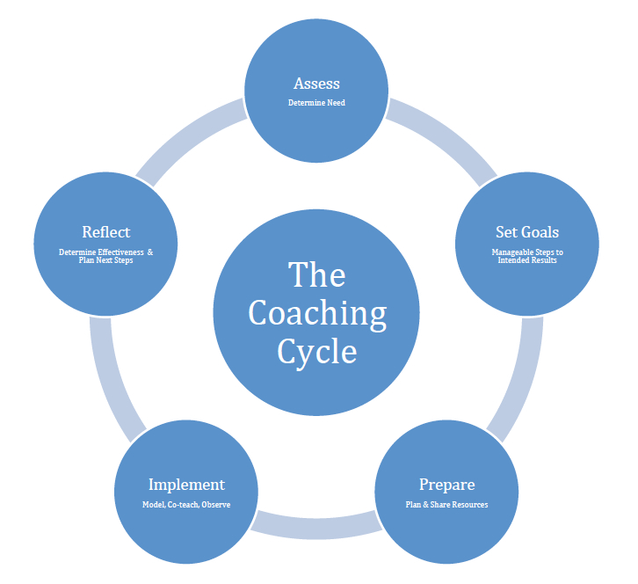
Do you act as a fundraising coach and educator for the CEO?

Slide 20
Do you act as a fundraising coach and educator for the CEO?
Things you need to accomplish the tasks:
Skill
Knowledge
Experience
Will
Motivation
Confidence
Notes:
Brainstorm – but also give ideas
Things you need CEO to accomplish the tasks
Skill
Knowledge – Know how to do it
Experience – Did it before
Will
Motivation – “I want to do it”
Confidence – “I can do it”

Slide 21
Embrace YOUR Mission
Your job is to support your CEO’s success. That’s what you were hired to do!
CEO’s don’t want people on their team who drag them down. They look for people to make them look like rock stars.
Understand and accept this as your mission.

Slide 22
Next Steps: What’s Your Plan?
Step 1: _____________________________________________
Step 2: _____________________________________________
Step 3: _____________________________________________
Step 4: _____________________________________________
Notes:
Jot down your initial plan/activities/tasks to turn your CEO into a fundraising rock star.
Be as specific as possible
Share if there is still time.

Slide 23
Joan Gerry
Successful fundraising happens when the Development Director and the CEO become an “us.”

Slide 24
QUESTIONS?

Slide 25
Roselle M. Ungar, CFRE Executive Director Jewish Family Service of Greater New Orleans 3300 W. Esplanade Avenue S., Suite 603 Metairie, LA 70002 roselle@jfsneworleans.org 504-831-8475 www.jfsneworleans.org

